Slide 1

Corona Virus Analysis
By: Yesner Alexander Tellez Salgado
Esta foto de Autor desconocido está bajo licencia CC BY-NC-ND

Slide 2

Overview:
The CORONA VIRUS pandemic has had a significant impact on public health and has created an urgent need for data-driven insights to understand the spread of the virus. As a data analyst, you have been tasked with analyzing a CORONA VIRUS dataset to derive meaningful insights and present your findings.

Slide 3

Dataset
Description of each column in dataset:
Province: Geographic subdivision within a country/region.
Country/Region: Geographic entity where data is recorded.
Latitude: North-south position on Earth's surface.
Longitude: East-west position on Earth's surface.
Date: Recorded date of CORONA VIRUS data.
Confirmed: Number of diagnosed CORONA VIRUS cases.
Deaths: Number of CORONA VIRUS related deaths.
Recovered: Number of recovered CORONA VIRUS cases.

Slide 4
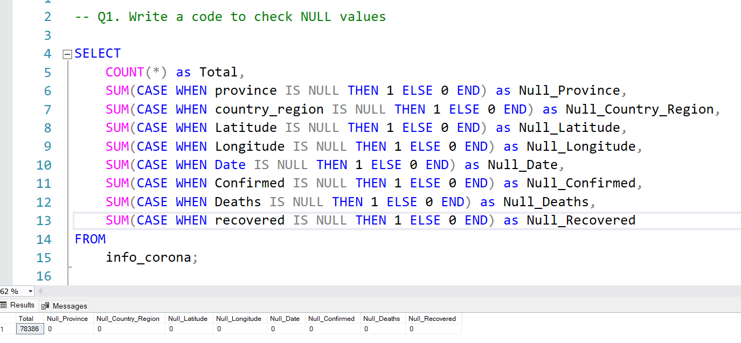

Slide 5
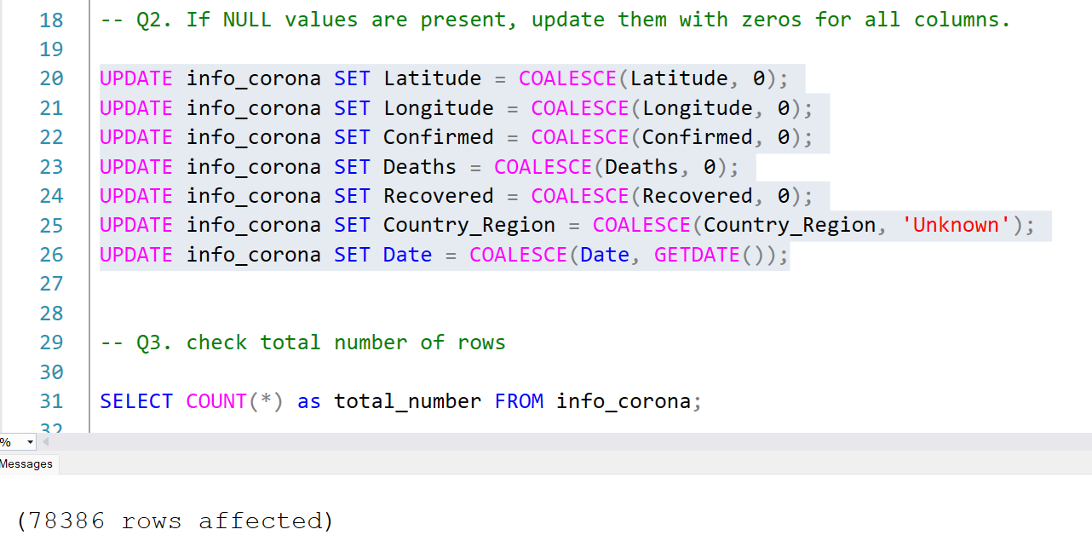

Slide 6
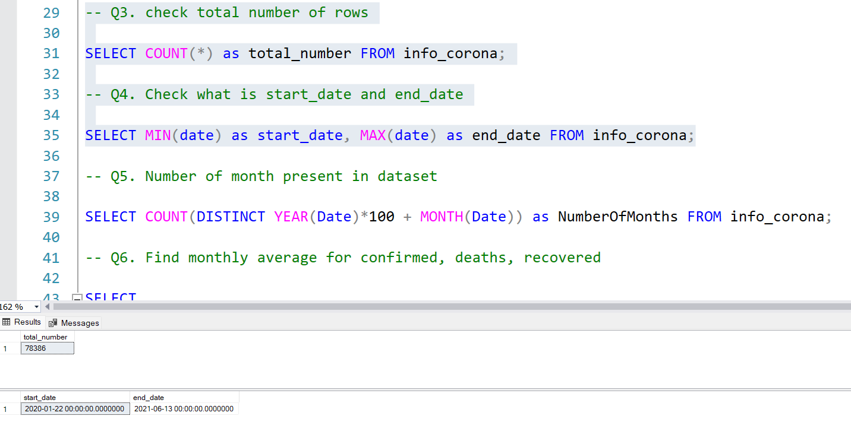

Slide 7
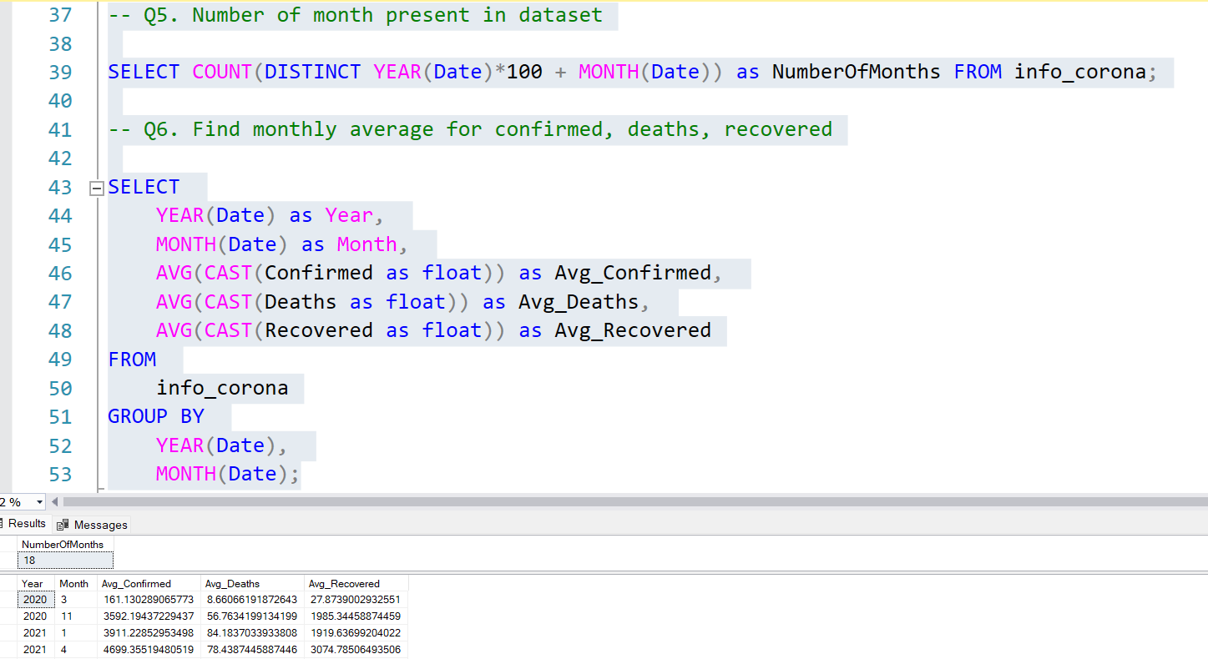

Slide 8
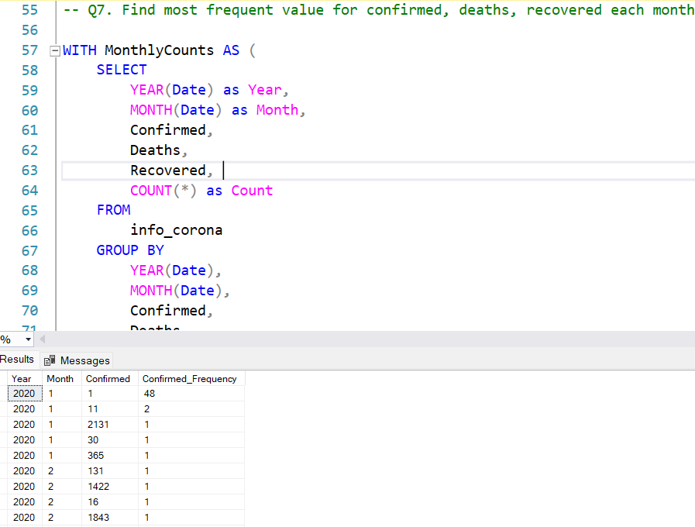

Slide 9
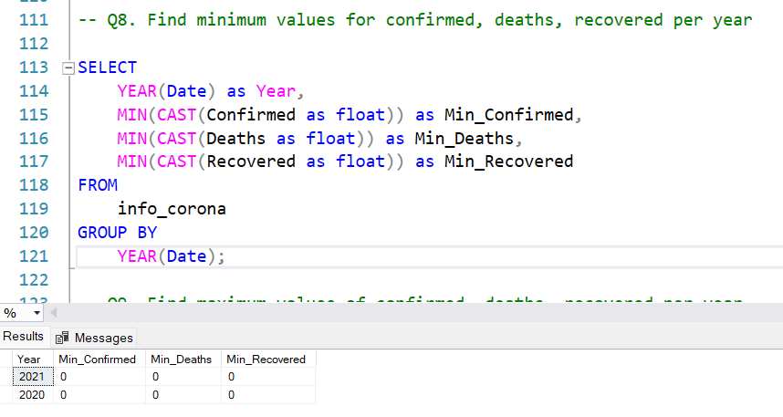

Slide 10
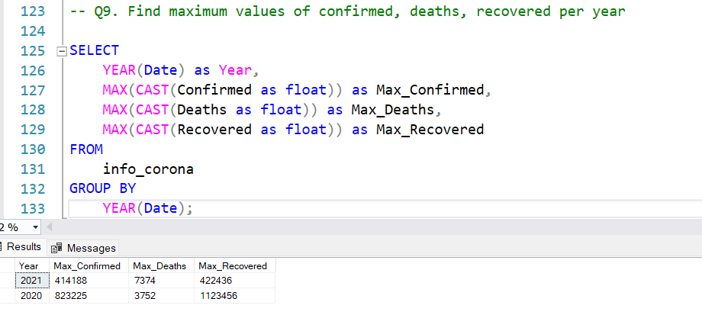

Slide 11
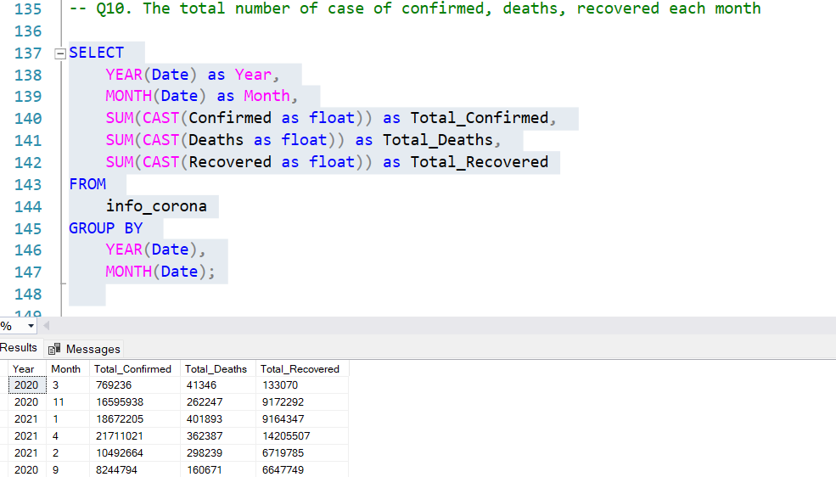

Slide 12
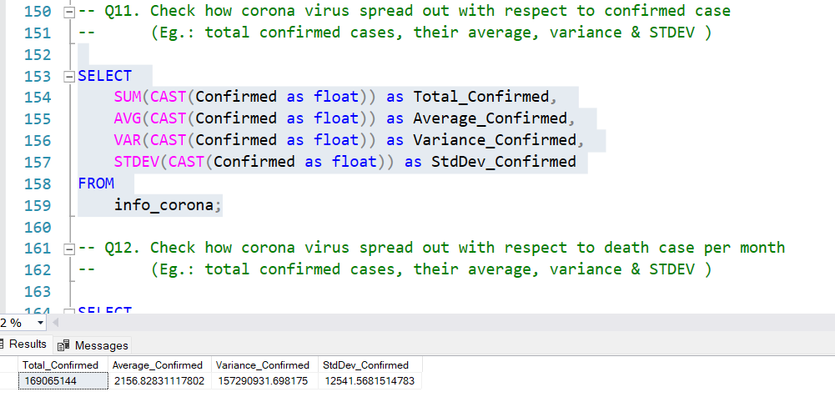

Slide 13
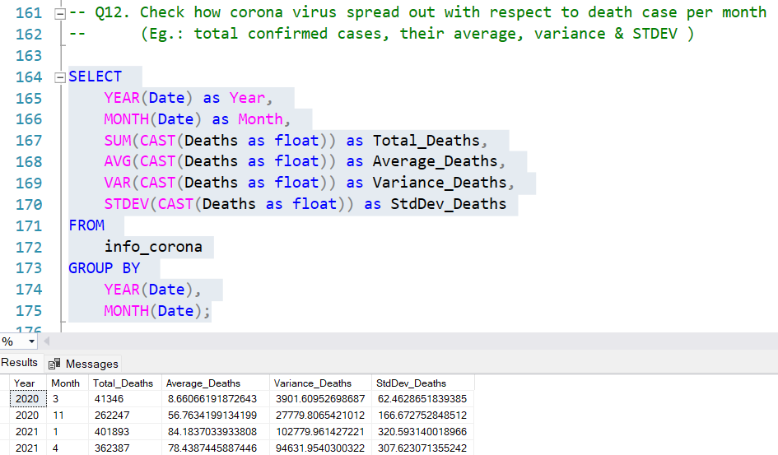

Slide 14
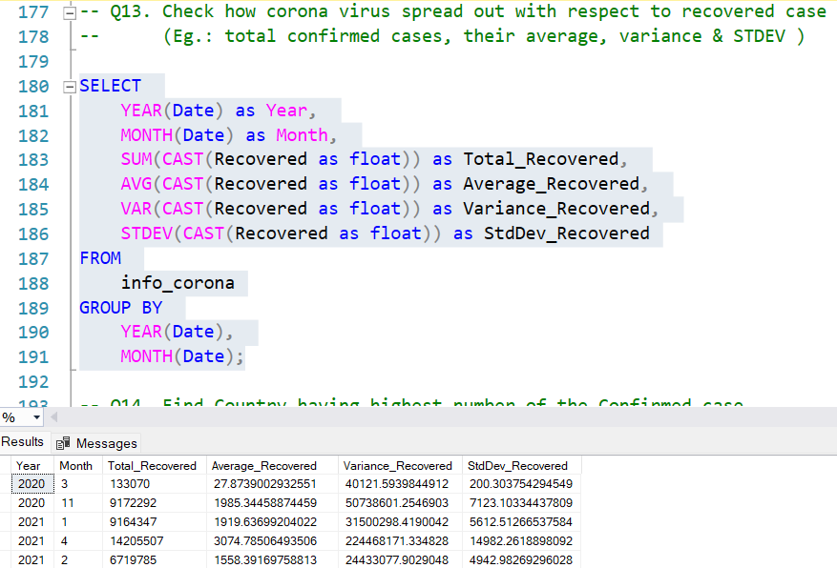

Slide 15
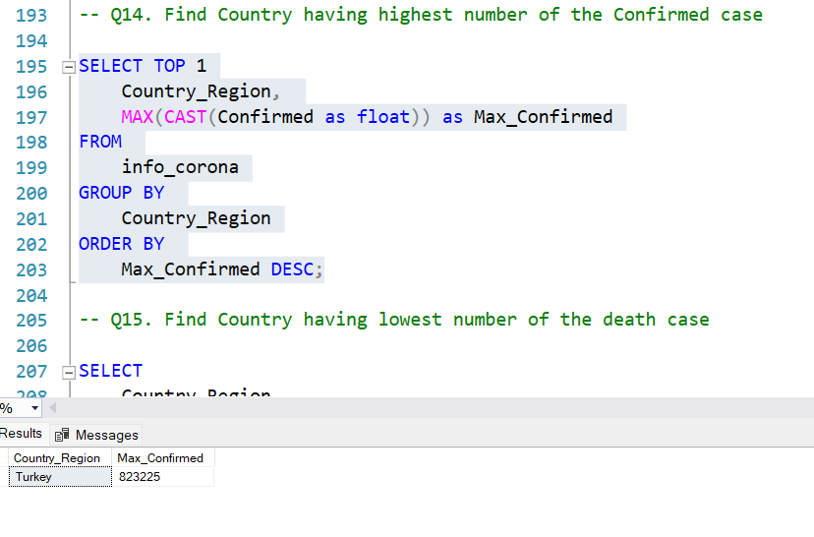

Slide 16
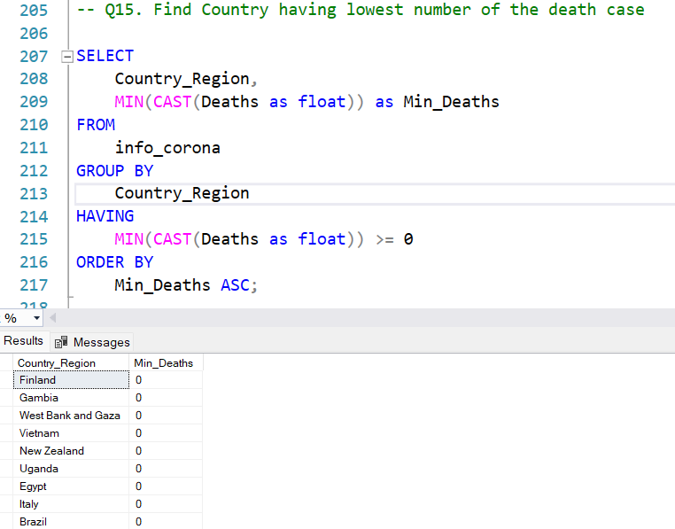

Slide 17
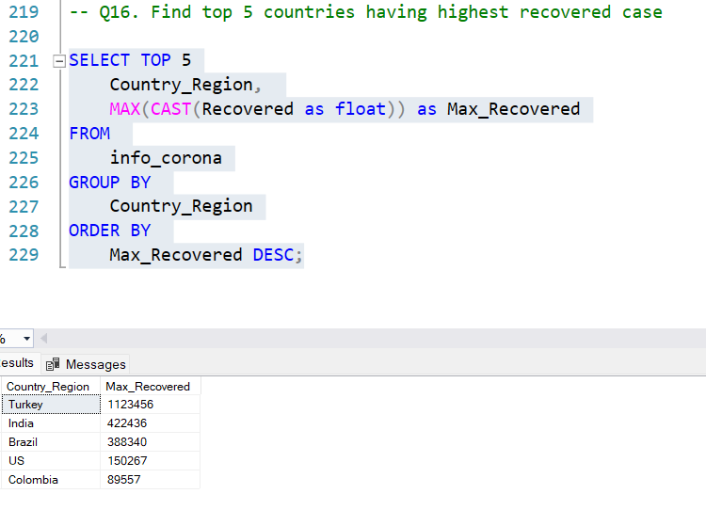

Slide 18

Results
Turkey had 1,123,456 recovered persons.
In the January 2021, was 84 deaths persons as avg with COVID-19 around the world.
In the May 2021, was 4,007 recovered persons as avg with COVID-19 around the world.
In the April 2021, was 4,699 confirmed persons as avg with COVID-19 around the world.

